Slide 1
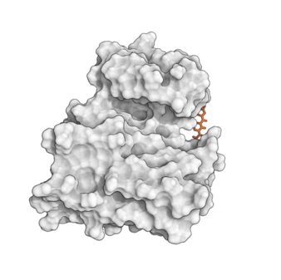
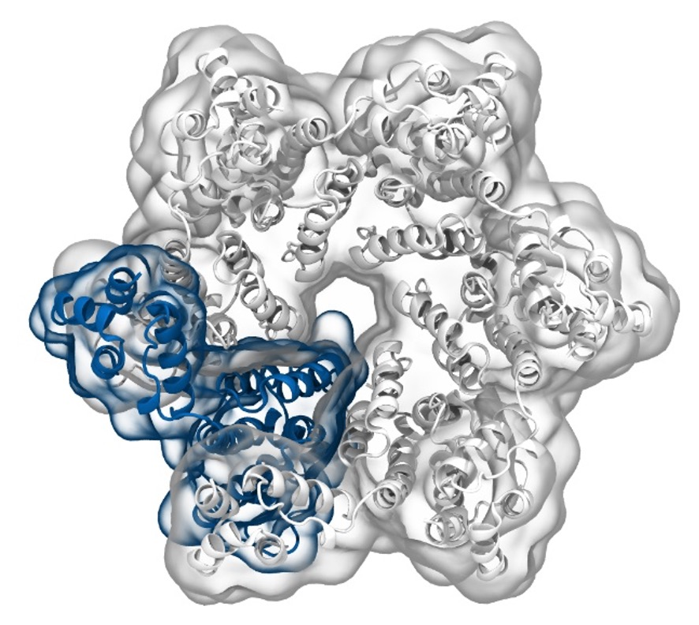
Simulation of Biomolecules
Introduction
2024 CCP5 Summer School
Dr Matteo Degiacomi
Durham University
matteo.t.degiacomi@durham.ac.uk
Dr Antonia Mey
University of Edinburgh
antonia.mey@ed.ac.uk

Slide 2

General Information
CCPBioSim Training week 2 - 6 September 2024 at the University of Sheffield and online.
Cost: £10/day
Registration closes: 2nd August 2024

Slide 3
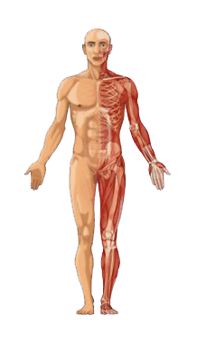

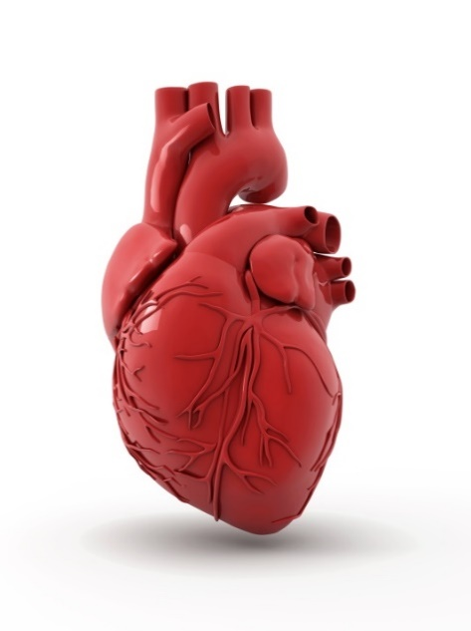
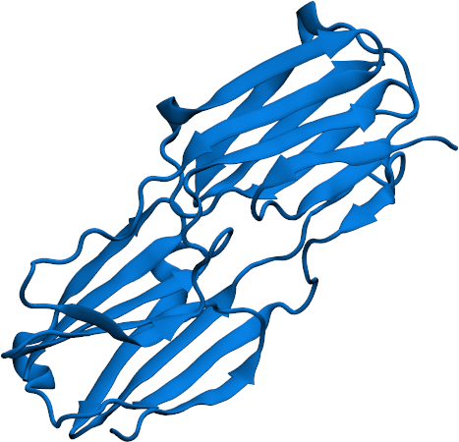
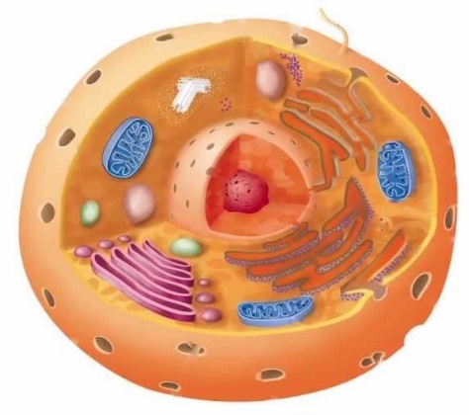
Life emerges from molecular assembly
COMPLEXITY

Slide 4

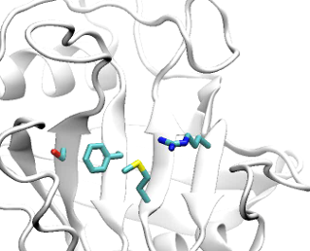
Structure and dynamics determine protein (mal)function
Cyclophilin
HIV Capsomer
Tyrosine kinase —dasatanib
M.T. Degiacomi, Structure, 2019
Wapeesittipan, Mey, et al., Comms. Chem., 2019
Y Shan et al. JACS, 2011
4

Slide 5
General Information
https://github.com/CCPBioSim/CCP5_Simulation_of_BioMolecules
Tuesday 23/7
Wednesday 24/7
Thursday 25/7
What are Proteins?
Protein MD preparation
Running MD
Protein-Ligand docking
Basic Data Analysis
Dimensionality Reduction
Clustering
Classification
Markov State Modelling
5

Slide 6
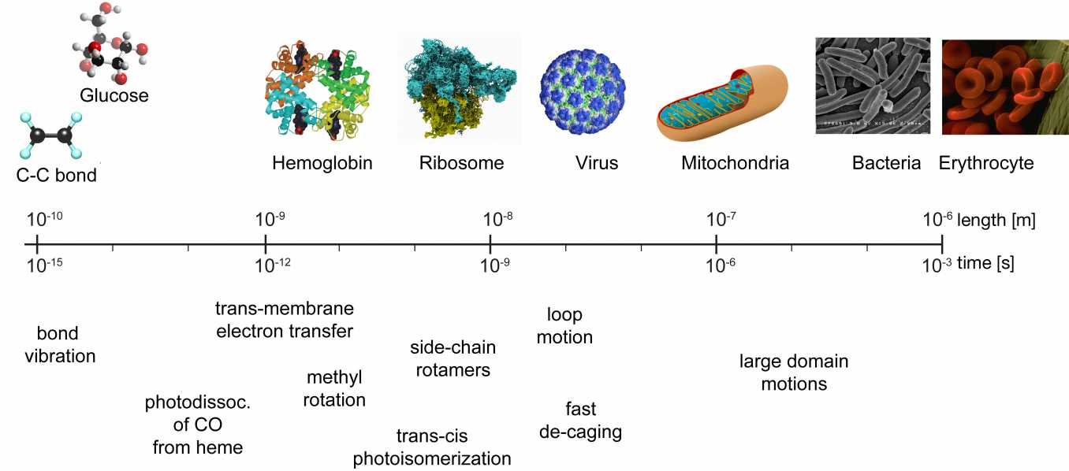
Sizes in biochemistry
Molecular Dynamics
6

Slide 7
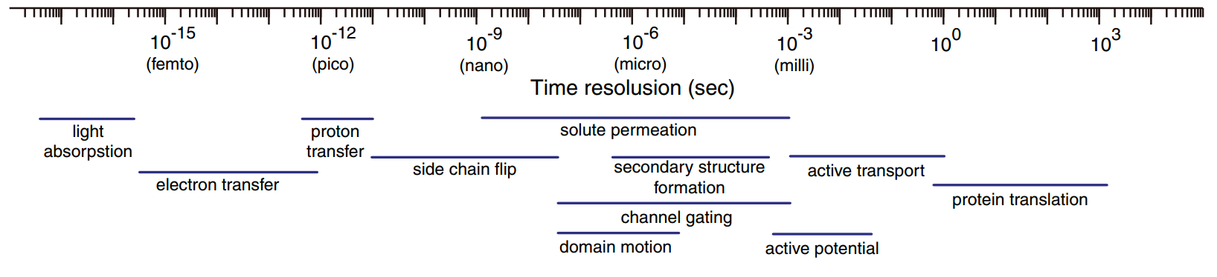
Timescales in biochemistry
Molecular Dynamics
Time resolution (sec)
Light absorption
Proton transfer
Solute permeation
Side chain flip
Secondary structure formation
Active transport
Electron transfer
Channel gating
Domain motion
Active potential
7

Slide 8
Part 1: what is a protein?

Slide 9
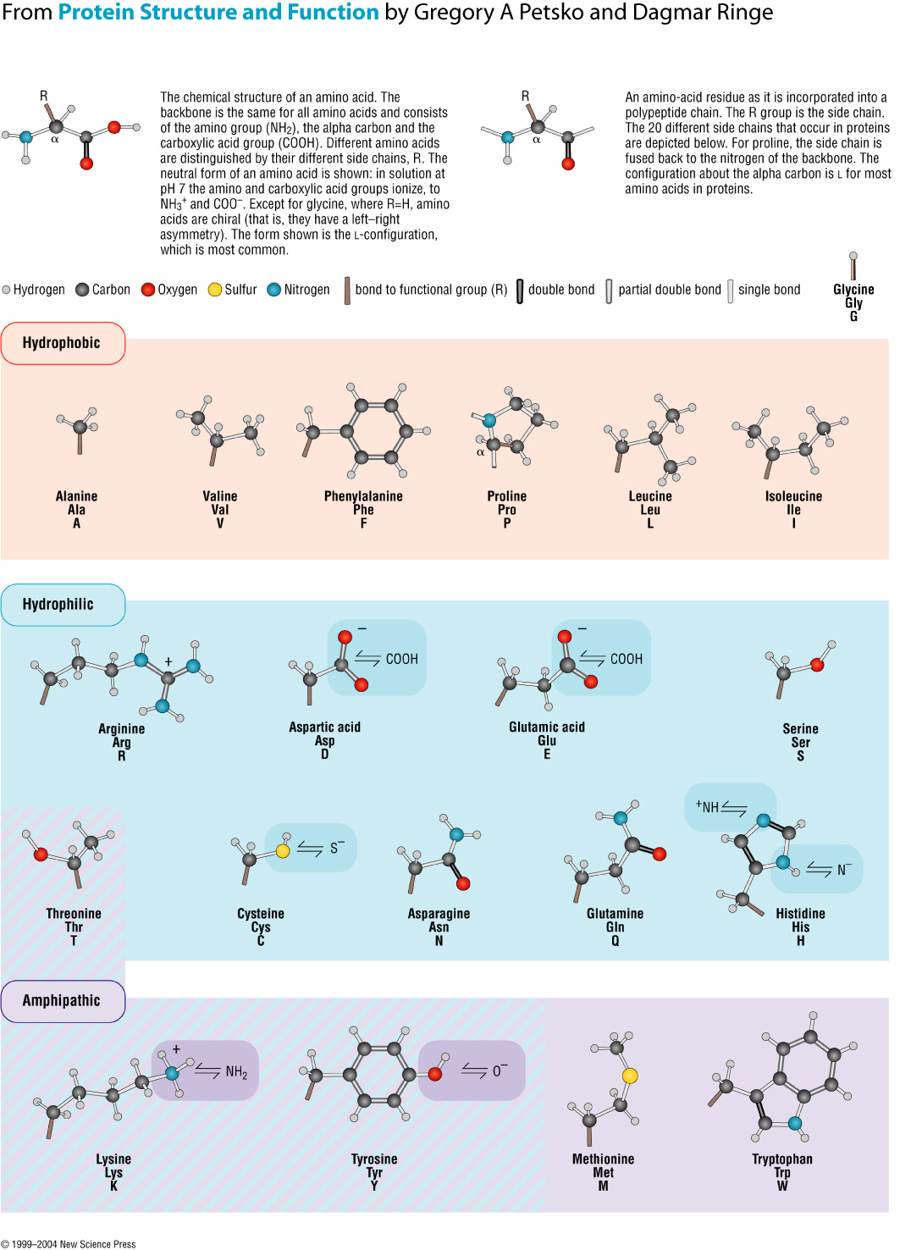
Proteins are amino acids polymers
Amino acids are composed of:
Backbone (conserved)
Side chain (variable)
Side
chain
-
+
α
@neutral pH

Slide 10
Proteins are amino acids polymers
Amino acids are composed of:
Backbone (conserved)
Side chain (variable)
Side
chain
α
α
Side
chain
Amino acids polymerize forming a peptidic bond (condensation)
Notes:
Écrire equation («c’est très simple!»)

Slide 11
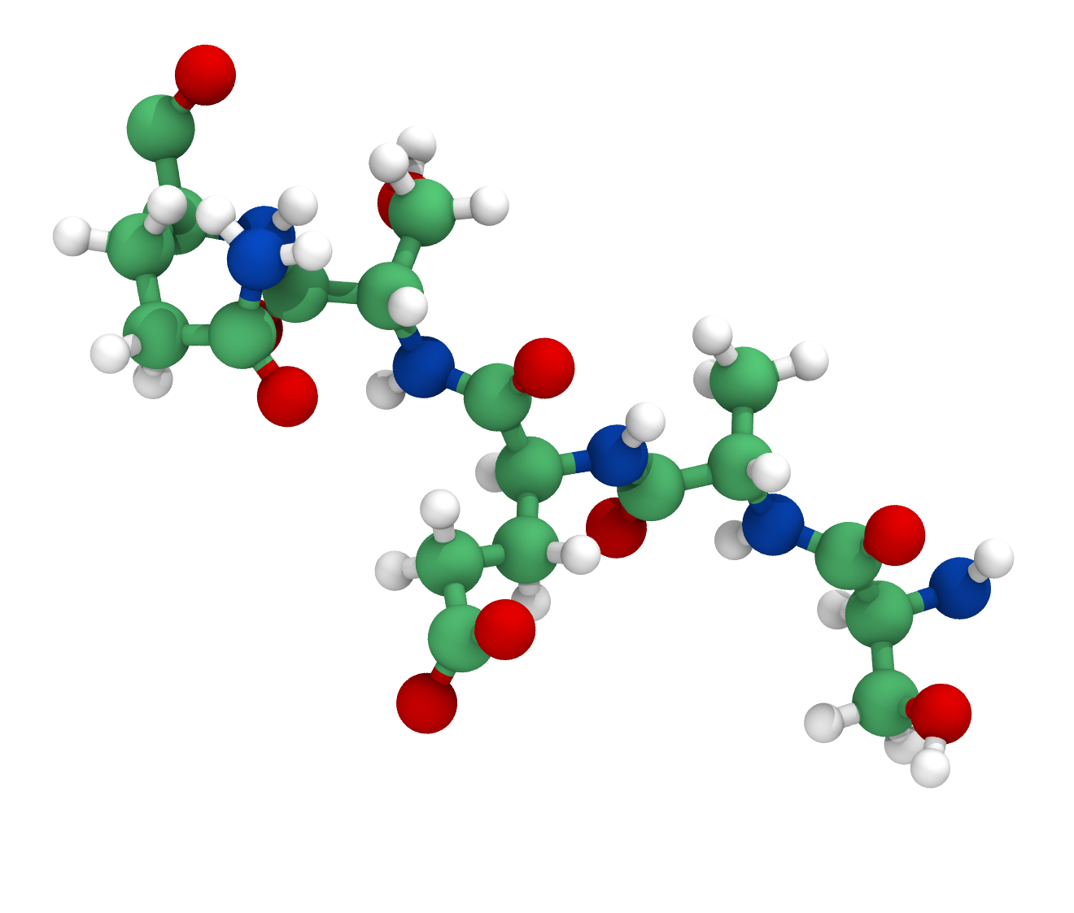
Proteins are amino acids polymers
Amino acids are composed of:
Backbone (conserved)
Side chain (variable)
Glutamic acid
GLU
E
Glutamine
GLN
Q
Serine
SER
S
Side
chain
α
α
Side
chain
Alanine
ALA
A
Serine
SER
S
Amino acids polymerize forming a peptidic bond (condensation)
11
Notes:
Écrire equation («c’est très simple!»)

Slide 12
Protein Primary Structure: Sequence
SAESQ
Proteins with similar sequence, likely:
have similar functions in an organism
are evolutionarily related
12

Slide 13
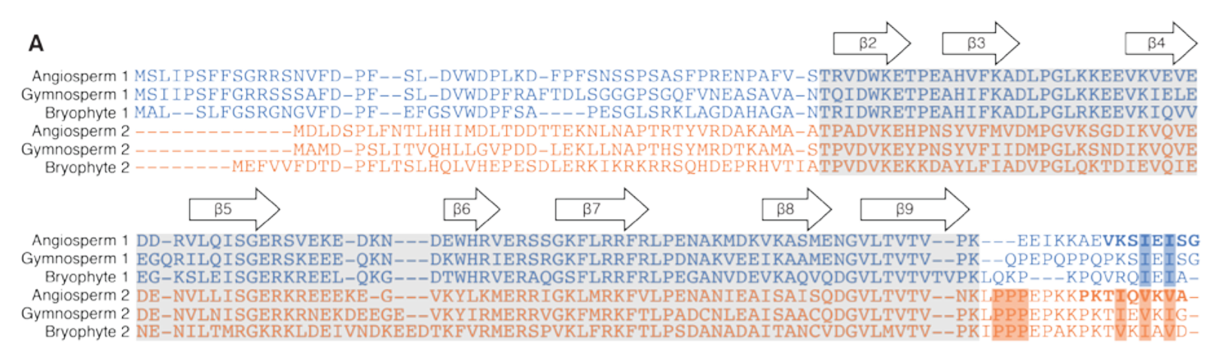
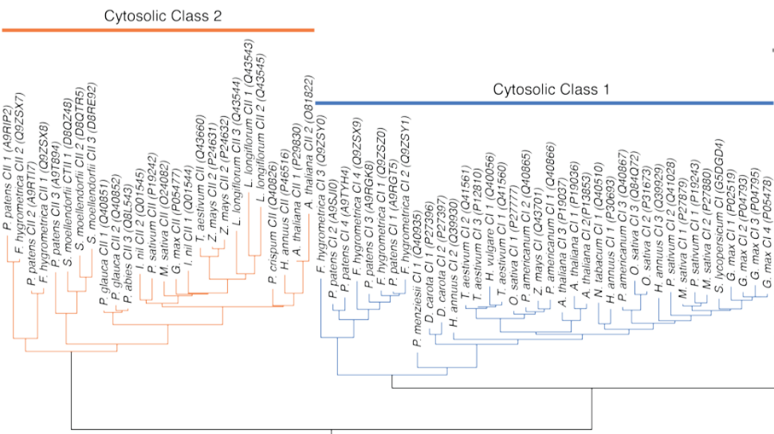
Protein Primary Structure: Sequence
Proteins with similar sequence, likely:
have similar functions in an organism
are evolutionarily related
G.K. Hochberg et al. Structural principles that enable oligomeric small heat-shock protein paralogs to evolve distinct functions. Science, 2018 [SI]

Slide 14
Protein Secondary Structure
The amino acid chain path is determined by backbone torsional angles
14

Slide 15
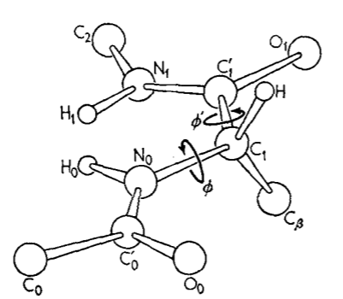
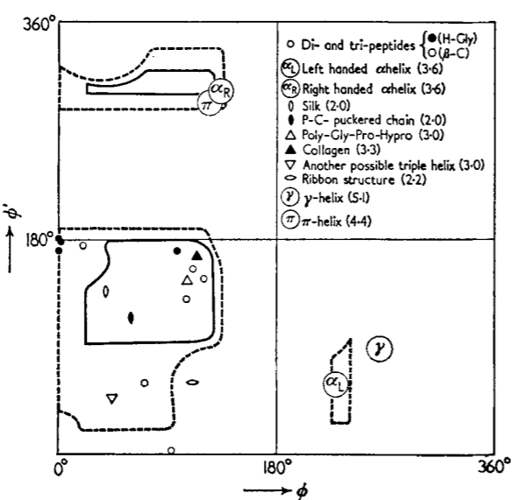
Protein Secondary Structure
The amino acid chain path is determined by backbone torsional angles
Ramachandran plot: scatter plot of amino acids backbone torsional angles
G.N. Ramachandran, C. Ramakrishnan, V. Sasisekharan. Stereochemistry of polypeptide chain configurations. Journal of Molecular Biology, 1963
15

Slide 16
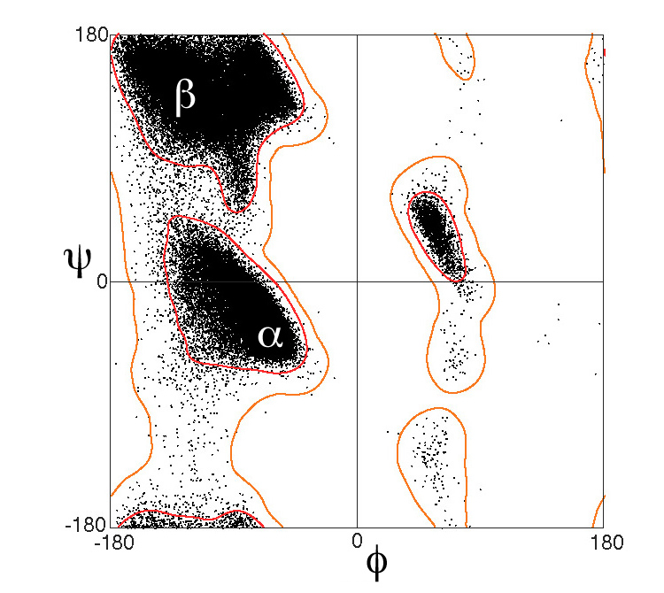
Protein Secondary Structure
The amino acid chain path is determined by backbone torsional angles
Ramachandran plot: scatter plot of amino acids backbone torsional angles
DSSP classification defines 7 secondary structure elements (regions in the plot):
H = α-helix
G = 3₁₀ helix
I = π-helix
B = residue in isolated β-bridge
E = extended strand
T = hydrogen bonded turn
S = bend
W. Kabsch and C. Sander, Dictionary of protein secondary structure: Pattern recognition of hydrogen‐bonded and geometrical features, Biopolymers, 1983
16

Slide 17
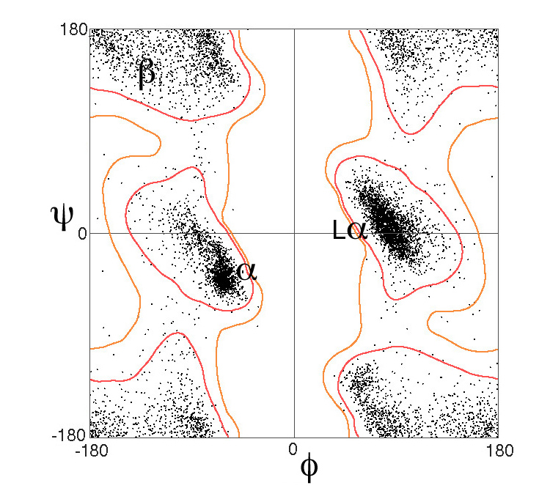
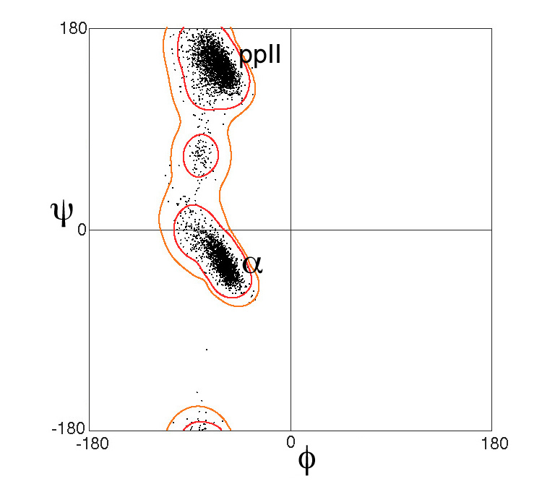
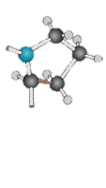
[Extra] Protein Secondary Structure
The amino acid chain path is determined by backbone torsional angles
Glycine
GLY
G
Ramachandran plot: scatter plot of amino acids backbone torsional angles
DSSP classification defines 7 secondary structure elements (regions in the plot):
H = α-helix
G = 3₁₀ helix
I = π-helix
B = residue in isolated β-bridge
E = extended strand
T = hydrogen bonded turn
S = bend
Proline
PRO
P
W. Kabsch and C. Sander, Dictionary of protein secondary structure: Pattern recognition of hydrogen‐bonded and geometrical features, Biopolymers, 1983
17

Slide 18
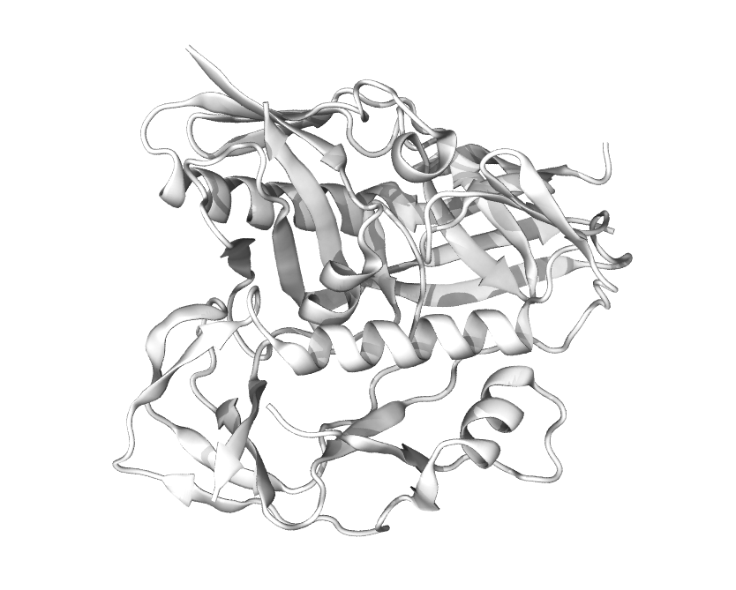
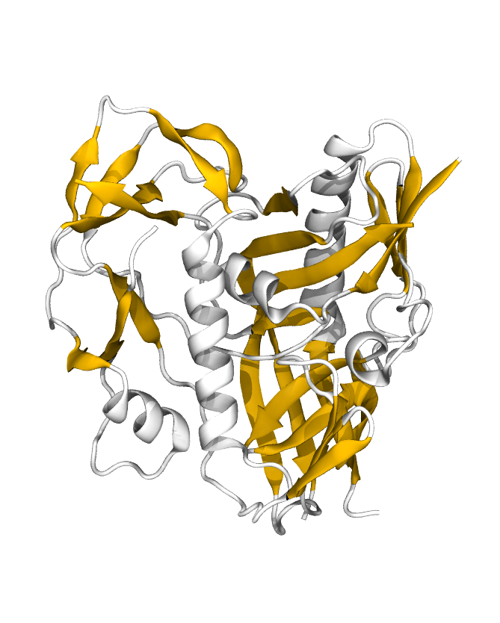
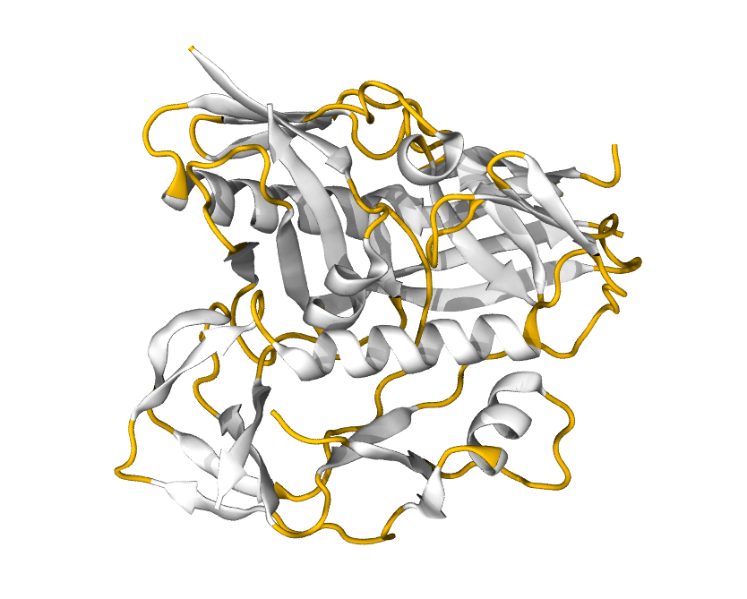
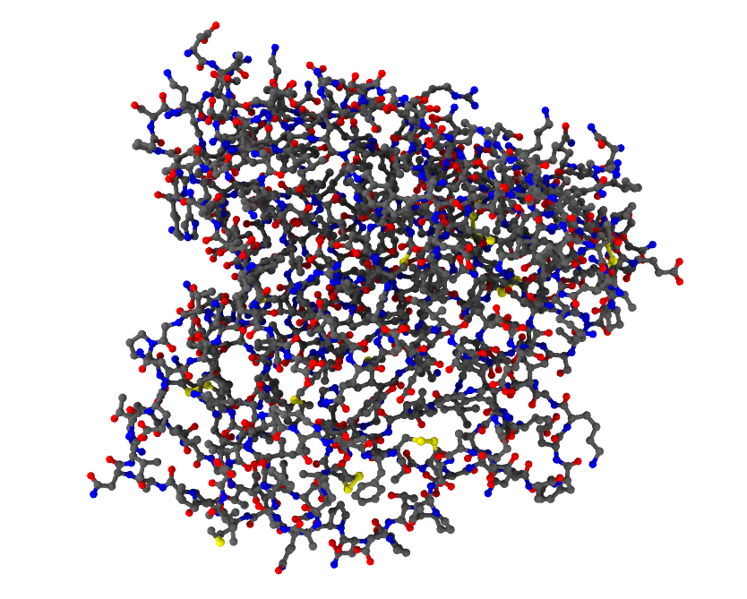
Protein tertiary structure: folding
Protein («polypeptide»): 10 to >1000 amino acids
18

Slide 19
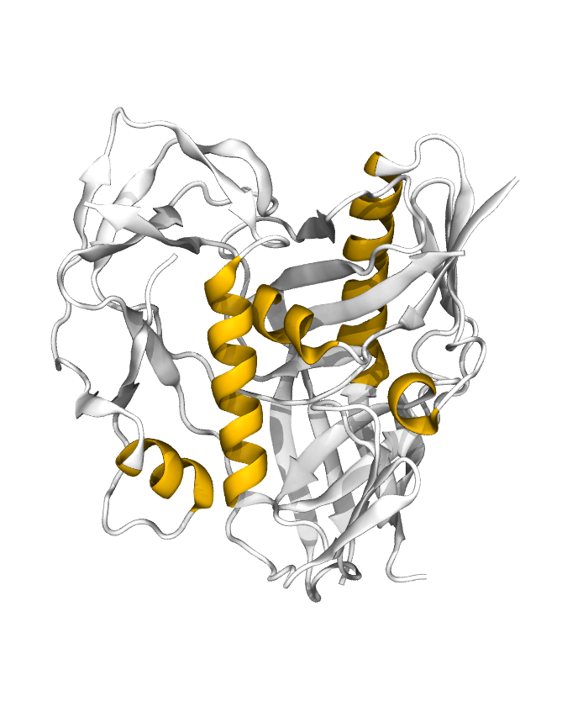
Protein tertiary structure: folding
Protein («polypeptide»): 10 to >1000 amino acids
Cartoon
representation:
helices
19

Slide 20
Protein tertiary structure: folding
Protein («polypeptide»): 10 to >1000 amino acids
Cartoon
representation:
sheets
20

Slide 21
Protein tertiary structure: folding
Protein («polypeptide»): 10 to >1000 amino acids
Cartoon
representation:
loops
21

Slide 22
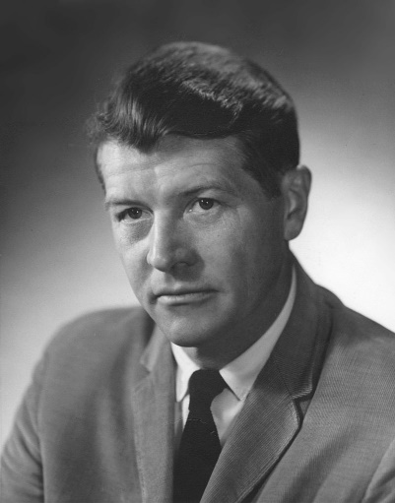
Protein tertiary structure: folding
Protein («polypeptide»): 10 to >1000 amino acids
Anfinsen’s dogma
The three-dimensional structure of a protein in its native environment is solely determined by its amino acid sequence.
Christian Anfinsen. Principles that govern the folding of protein chains. Science, 1973
22
Notes:
Nobel in 1972

Slide 23
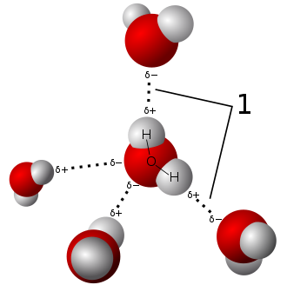
Hydrogen bonds
Electrostatic interaction. Structure:
donor-acceptor distance typically 1.6-2 Å
donor-acceptor-hydrogen angle must be small
Hydrogen bond energy in biomolecular systems typically 5-25 kJ/mol, e.g.:
O−H···:O , 21 kJ/mol (5.0 kcal/mol)
N−H···:O , 8 kJ/mol (1.9 kcal/mol)
amino acids’ backbone and polar side chains can be donor/acceptor
23

Slide 24
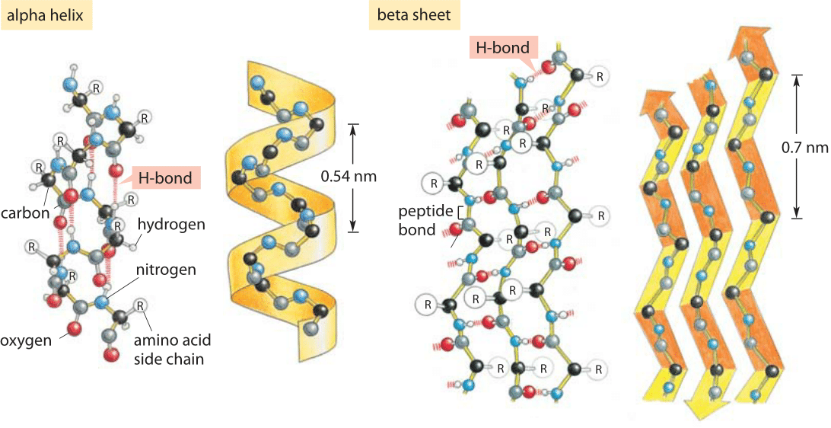
Hydrogen bonding on protein backbone
book.bionumbers.org
24

Slide 25
Hydrogen bonding on protein backbone
book.bionumbers.org
25

Slide 26
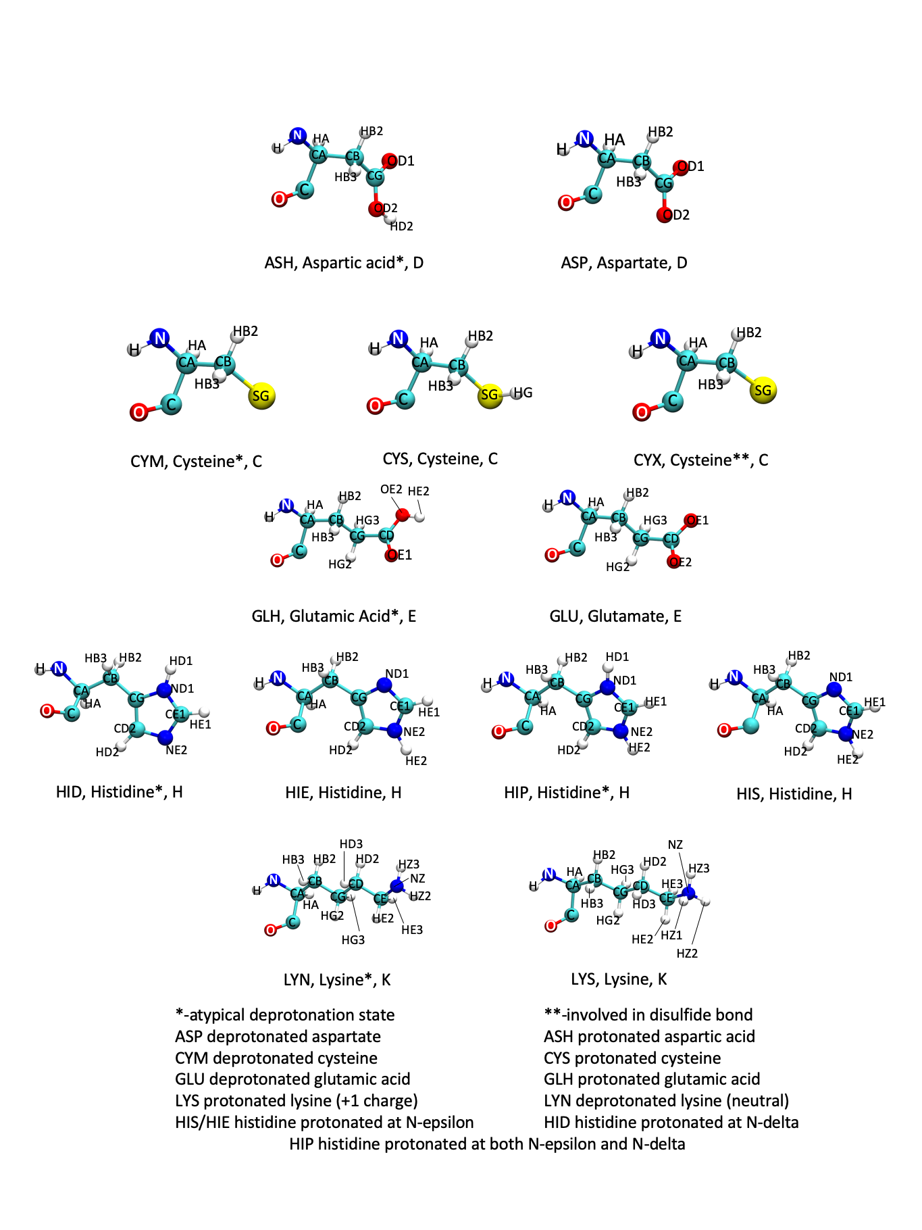
Hydrogen bonding: effect of local pH
26

Slide 27
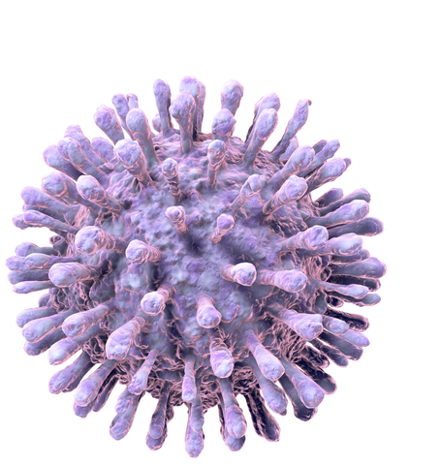
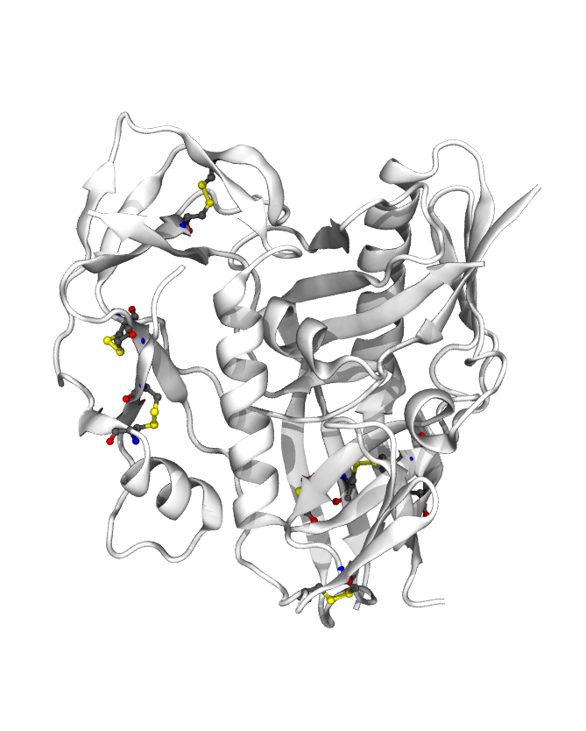
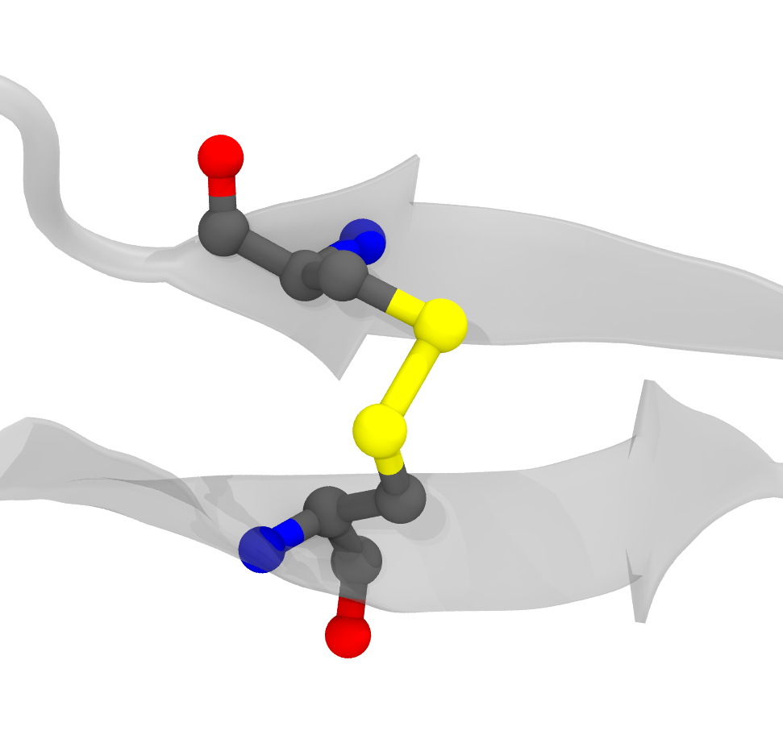
Disulfide bridges
Under oxidising conditions, cysteine side chains can form a covalent bond.
Protein more resistent to denaturation
Changes in conditions structural change
HIV-1 virus
gp120, PDB: 5F4L
T.J.Bechtel and E.Weerapana, From structure to redox: the diverse functional roles of disulfides and implications in disease, Proteomics, 2017
27
Notes:
NEGATIVE deltaH = exothermic (energy is released). Bond formation is exothermic.
Keratin (in hair) contains 14% cysteine. When you burn hair, you smell sulfur.
HIV-1 gp120, interaction with thioredoxin leads to conformational change promoting virus inserion
Oxydation: loss of an electron (increase in oxydation state)
Reduction: gain of eletron (decrease in oxydation state)
In eucaryots, endoplasmic reticulum (where proteins fold) is an oxydising environment, while cytoplasm is reducing

Slide 28
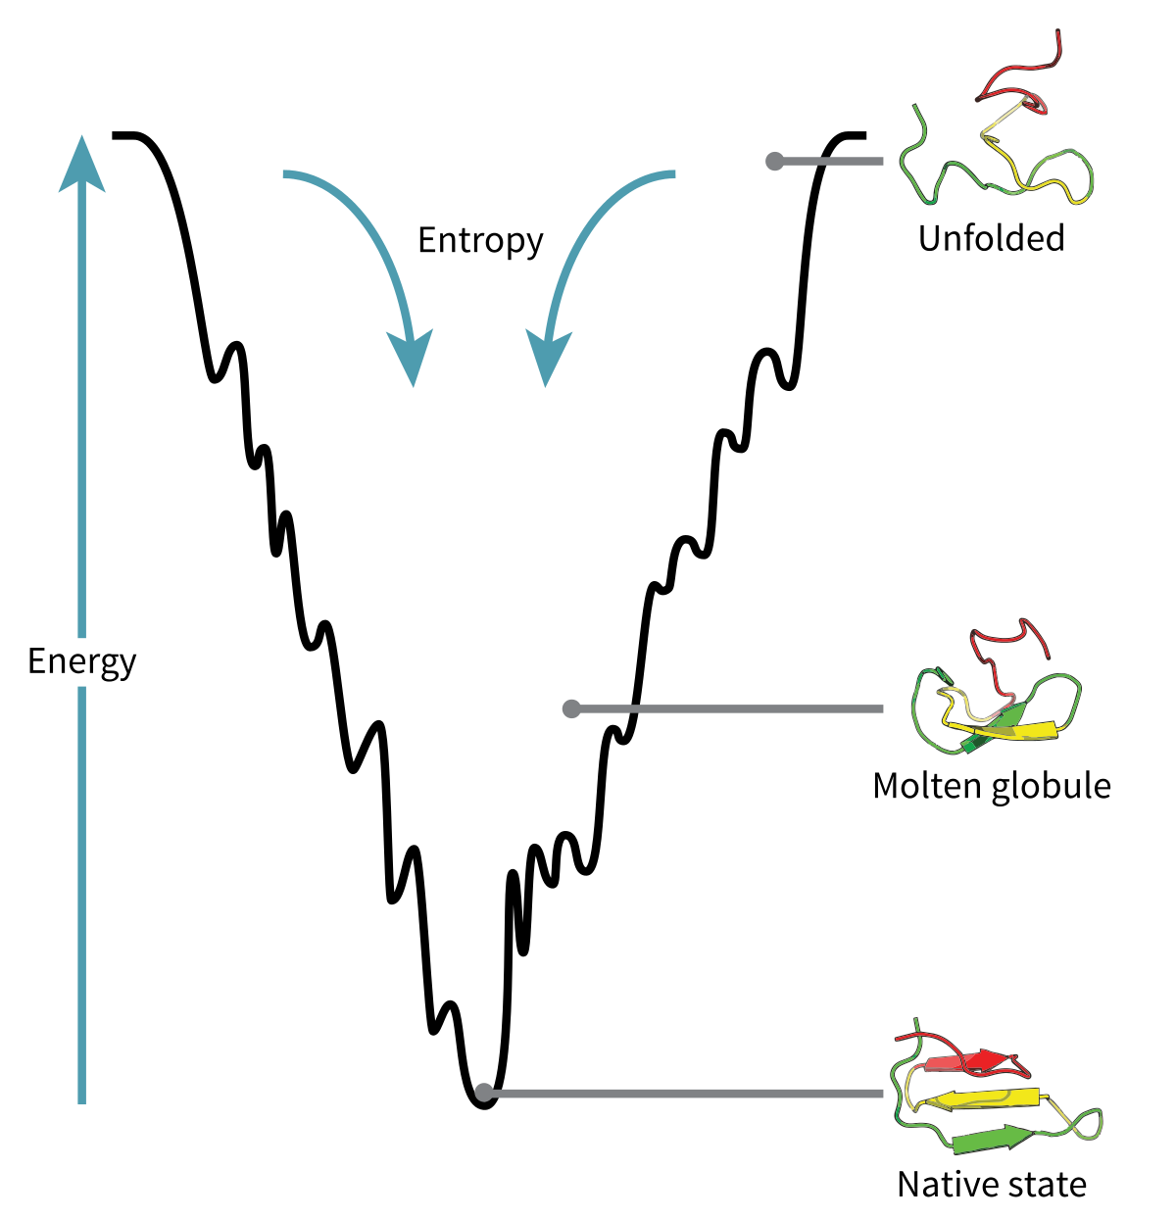
[Extra] Proteins fold in low energy structures
ΔG = ΔH – TΔS
Proteins fold spontaneously, i.e. ΔG < 0
ΔS_{protein} is < 0
ΔS = ΔS_{protein} + ΔS_{water} > 0
28
Notes:
If you consider an unfolded protein, there are millions of ways that protein can be unfolded and so the entropy of the protein is high, instead there is only one way that the protein can be folded properly.
Bond formation, e.g. disulphide, is exothermic, i.e. negative ΔH
An incorrect and simplistic view of protein folding is as follows. An unfolded protein has high configurational entropy but also high enthalpy because it has few stabilizing interactions. A folded protein has far less entropy, but also far less enthalpy. There is a tradeoff between H and S here. Note that because ΔG = ΔH - TΔS, increased temperature weights the S term more heavily, meaning that higher temperature favors unfolding.
That entire explanation only considers the energy of the protein and not that of the solvent. In fact, hydrophobic domains of a protein constrain the possible configurations of surrounding water (see explanation above), and so their burial upon folding increases the water’s entropy. Moreover, it turns out that the hydrogen bonding of polar residues and the backbone is satisfied both in an unfolded state (by water) and in a folded state (by each other). Therefore enthalpy is “zero sum,” and protein folding is driven almost entirely by entropy.

Slide 29
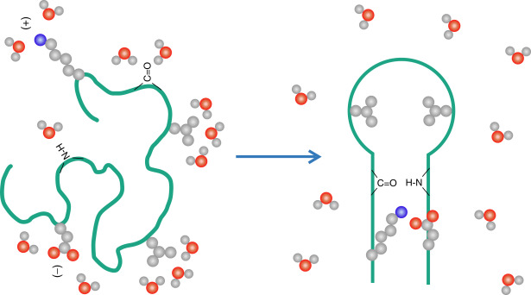
[Extra] Proteins fold in low energy structures
ΔG = ΔH – TΔS
Proteins fold spontaneously, i.e. ΔG < 0
ΔS_{protein} is < 0
ΔS = ΔS_{protein} + ΔS_{water} > 0
H = U + PV; at physiological conditions ΔH≈ΔU
ΔH is small: a folded protein forms bonds with itself, an unfolded one forms bonds with water.
Hydrophobic collapse drives folding!
29
Notes:
If you consider an unfolded protein, there are millions of ways that protein can be unfolded and so the entropy of the protein is high, instead there is only one way that the protein can be folded properly.
In order for folding to occur spontaneously, the change in free energy of the process must be negative.
everywhere there is a nonpolar side chain, there is a mini iceberg surrounding it.
An incorrect and simplistic view of protein folding is as follows. An unfolded protein has high configurational entropy but also high enthalpy because it has few stabilizing interactions. A folded protein has far less entropy, but also far less enthalpy. There is a tradeoff between H and S here. Note that because ΔG = ΔH - TΔS, increased temperature weights the S term more heavily, meaning that higher temperature favors unfolding.
That entire explanation only considers the energy of the protein and not that of the solvent. In fact, hydrophobic domains of a protein constrain the possible configurations of surrounding water (see explanation above), and so their burial upon folding increases the water’s entropy. Moreover, it turns out that the hydrogen bonding of polar residues and the backbone is satisfied both in an unfolded state (by water) and in a folded state (by each other). Therefore enthalpy is “zero sum,” and protein folding is driven almost entirely by entropy.
a polypeptide of 100 residues will have 99 peptide bonds, and therefore 198 different phi and psi bond angles. If each of these bond angles can be in one of three stable conformations, the protein may misfold into a maximum of 3¹⁹⁸ different conformations

Slide 30
[Extra] Levinthal’s paradox
How can proteins find their unique fold in sub-second timescales?
100 amino acids-long protein
2x100 - 2 = 198 backbone torsional angles
each torsional angle has on average 3 stable positions
3¹⁹⁸ different configurations
side chain rotation in the fs timescale (10⁻¹² s)
random search worst case scenario: 10⁻¹² x 3¹⁹⁸ ≈ 10⁻¹² x 10⁹⁹ = 10⁸⁷ s
age of the universe ≈ 13.7 billion years = 4.32x10¹⁷ s
Protein folding cannot be a random process
Cyrus Levinthal. How to Fold Graciously. Mossbauer Spectroscopy in Biological Systems: Proceedings of a meeting held at Allerton House, Monticello, Illiois, 1969
30

Slide 31
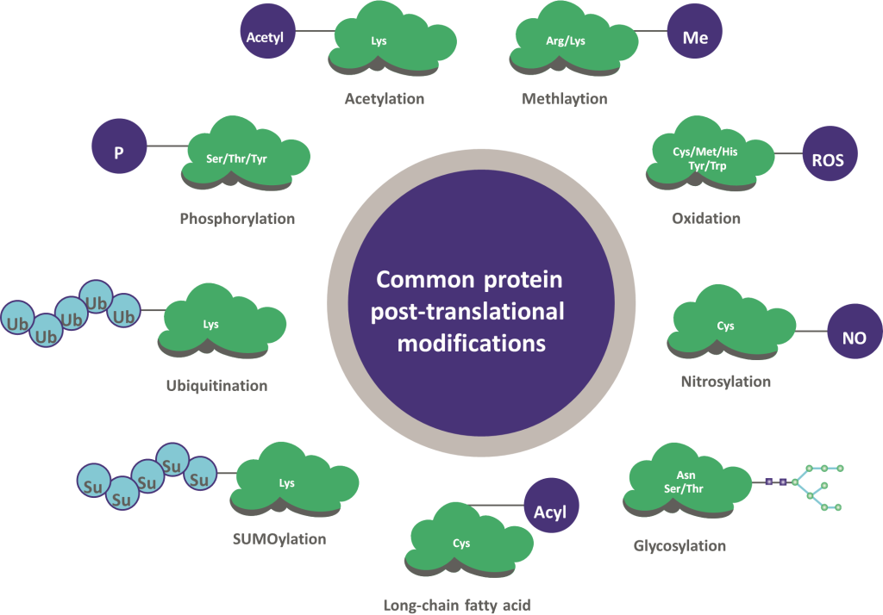
Post-translational modifications (PTMs)
Once expressed, proteins can be modified by the covalent binding of other molecules.
The addition/removal of most PTMs is controlled by the organism, to modulate protein function.
www.raybiotech.com/learning-center/translating-diversity-to-discovery

Slide 32
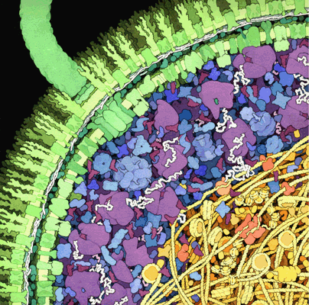
The intracellular space
Crowded environment!
David G. Goodsell, The machinery of Life, Springer
32

Slide 33
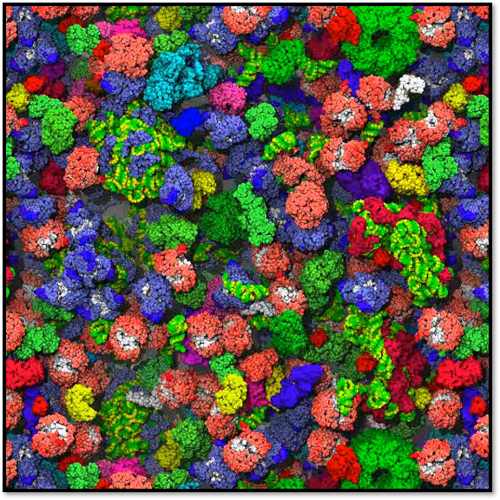
The intracellular space
Crowded environment!
Brownian motion: proteins bump into other molecules all the time!
Most contacts are short-lived
S. McGuffee et al., PLoS Comp. Biol., 2010

Slide 34
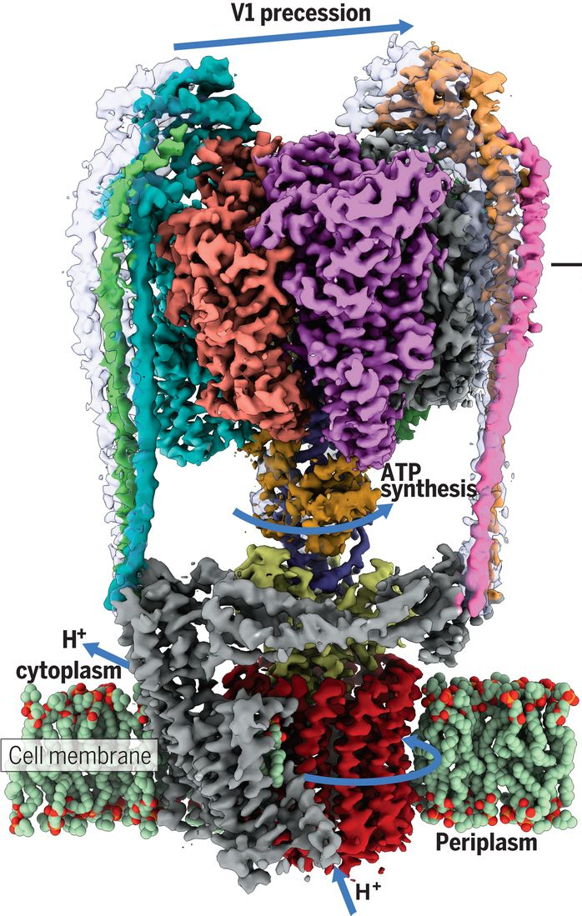
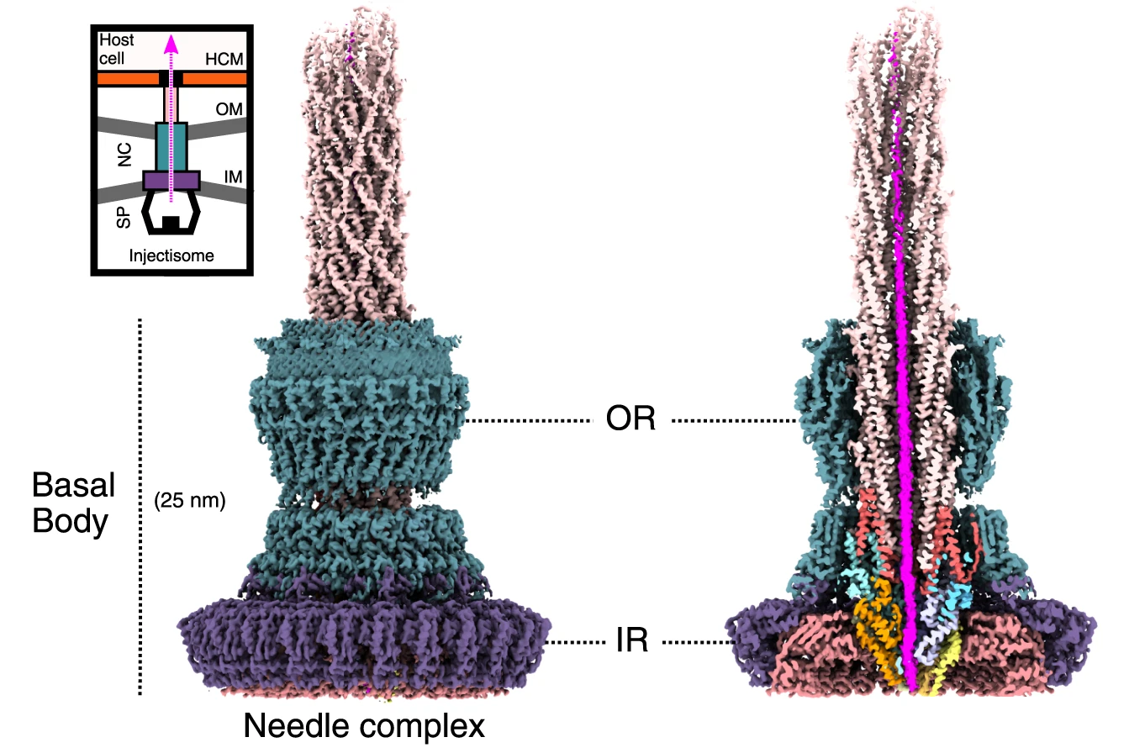
Protein quaternary structure: assembly
ATP syntase
Injectisome
L. Zhou and L. A. Sazanov, Structure and conformational plasticity of the intact Thermus thermophilus V/A-type ATPase, Science, 2019
S. Miletic et al., Substrate-engaged type III secretion system structures reveal gating mechanism for unfolded protein translocation, Nature Comms, 2021
34
Notes:
The rotor alone can operate at 6,000 to 17,000 rpm, but with the flagellar filament attached usually only reaches 200 to 1000 rpm.
NEW ARTICLE: Substrate-engaged type III secretion system structures reveal gating mechanism for unfolded protein translocation | Nature Communications

Slide 35
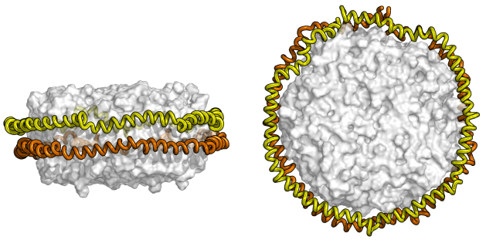
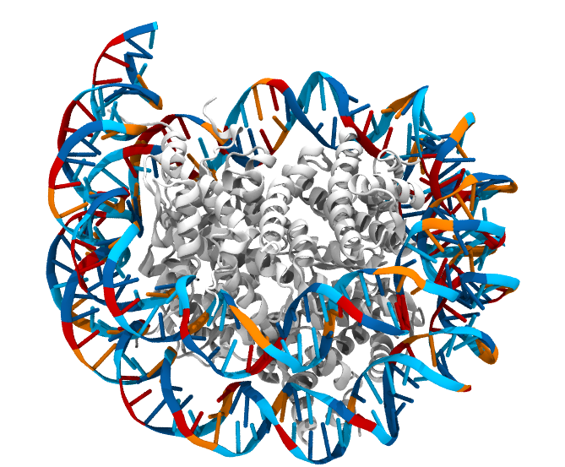
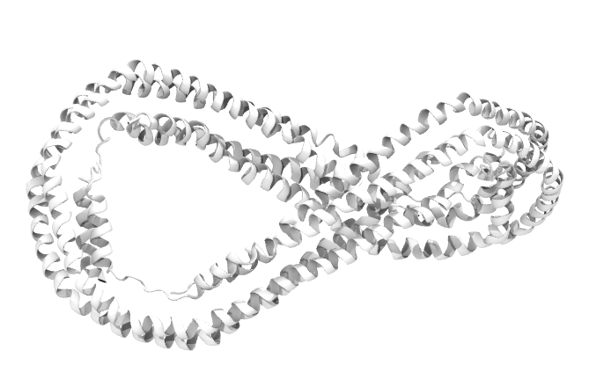
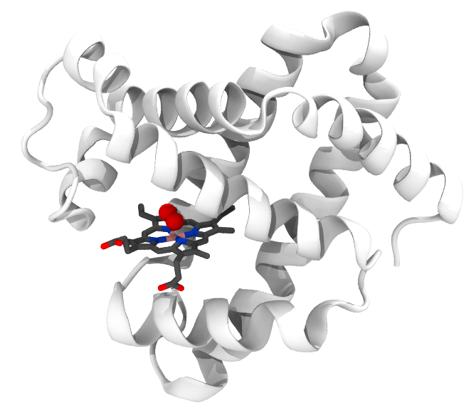
The structure determines the function
Nucleosome (PDB: 5CPI)
Myoglobin (PDB: 1MBO)
Lipoprotein (PDB: 1AV1)
K. Luger et al., Crystal Structure of the nucleosome core particle at 2.8 A resolution, Nature, 1997
D.W. Bohrani et al., Crystal structure of truncated human apolipoprotein A-I suggests a lipid-bound conformation, PNAS, 1997
J.C. Kendrew et al., A three-dimensional Model of the Myoglobin Molecule obtained by X-Ray Analysis, Nature, 1958
35
Notes:
ADD A REFERENCE FOR LIPOPROTEIN!

Slide 36
Proteins, illness, and drug design
Proteins and diseases (e.g. covid-19, salmonella, flu, ...)
pathogen’s own metabolism/structure
pathogen’s weapon
Proteins and disorders (e.g. Cancer, Alzheimer, ...)
own protein misfolds
own protein folds, but has different dynamics
Drug
Small molecule designed to specifically bind to a protein, so as to affect its function
36

Slide 37
Part 2: structure determination

Slide 38
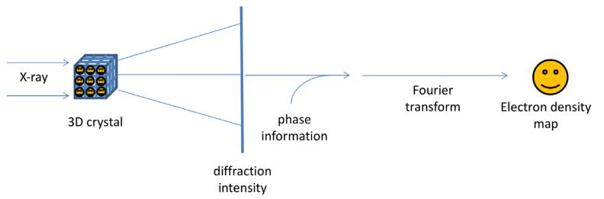
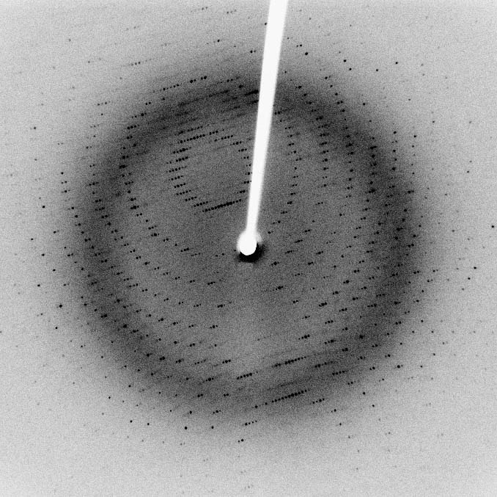
Structure determination: X-ray crystallography
www.creative-biostructure.com/comparison-of-crystallography-nmr-and-em_6.htm
38

Slide 39
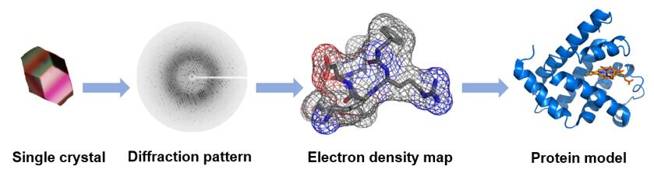
Structure determination: X-ray crystallography
www.creative-biostructure.com/comparison-of-crystallography-nmr-and-em_6.htm
39

Slide 40
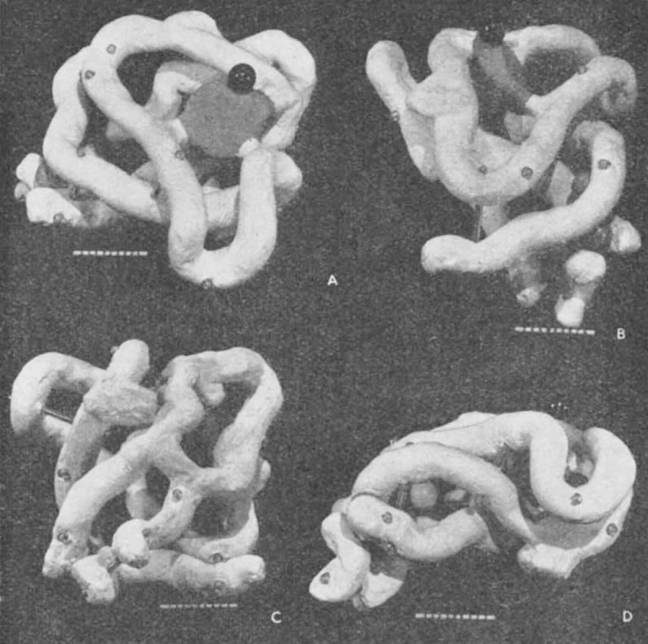
Structure determination: X-ray crystallography
J.C. Kendrew et al., A three-dimensional Model of the Myoglobin Molecule obtained by X-Ray Analysis, Nature, 1958

Slide 41
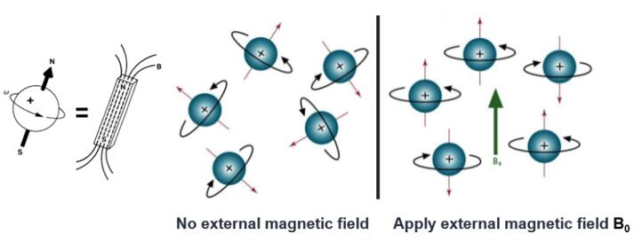
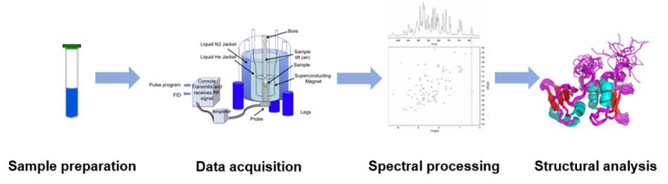
Structure determination: Nuclear Magnetic Resonance (NMR)
www.creative-biostructure.com/comparison-of-crystallography-nmr-and-em_6.htm
41

Slide 42
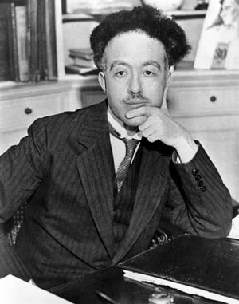
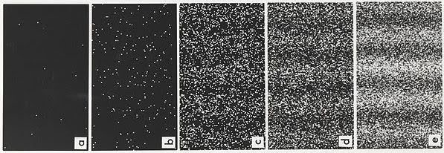

[Extra] Structure determination: Electron Microscopy (EM)
Particles as «waves that transfers energy and momentum»
$\text{λ}= \frac{h}{p}$
λ : wavelength
p : momentum
h : Planck constant
Davisson–Germer experiment: electrons diffract too!
Louis De Broglie
1892-1987
A. Tonomura et al., Demonstration of single-electron buildup of an interference pattern, American Journal of Physics, 1989
42
Notes:
Explain experiment, show images!

Slide 43


Structure determination: Electron Microscopy (EM)
M. V. Ruiter et al., Structural nanotechnology: three-dimensional cryo-EM and its use in the development of nanoplatforms for in vitro catalysis, Nanoscale, 2019
43

Slide 44
Structure determination: Electron Microscopy (EM)
Resolution Revolution
www.creative-biostructure.com/comparison-of-crystallography-nmr-and-em_6.htm
44

Slide 45





The Protein Data Bank (PDB)
Molecular structures are deposited in the Protein Data Bank (PDB)
1971: foundation of PDB at Brookhaven National Laboratory
45
Notes:
https://www.rcsb.org/pages/about-us/history

Slide 46

The Protein Data Bank (PDB)
Molecular structures are deposited in the Protein Data Bank (PDB)
1971: foundation of PDB at Brookhaven National Laboratory
2003: wwPDB founded
now with four deposition centres
Each molecule assigned a unique 4-characters code (e.g. 1MBO, 1AV1, …)
H.Berman, K.Henrick and H. Nakamura, Announcing the worldwide Protein Data Bank. Nature Structural & Molecular Biology, 2003
wwPDB consortium , Protein Data Bank: the single global archive for 3D macromolecular structure data, Nucleic Acids Research, 2019
46
Notes:
https://www.rcsb.org/pages/about-us/history

Slide 47

The Protein Data Bank (PDB)
47

Slide 48

The Protein Data Bank (PDB)
known protein structures: ~80’000 (PDB, 90% identity)
known protein sequences: ~190’000’000 (UNIPROT)
48

Slide 49

Protein fold prediction
CASP, since 1994 biennial competition on protein fold prediction: predictioncenter.org
prediction
49

Slide 50

Protein fold prediction
prediction
A.W. Senior et al., Improved protein structure prediction using potentials from deep learning, Nature, 2020
J. Jumper et al., Highly accurate structure prediction with AlphaFold, Nature, 2021
E. Callaway, ‘It will change everything’: DeepMind’s AI makes gigantic leap in solving protein structures, Nature, 2021
50
Notes:
NEW RESULTS TO BE ADDED

Slide 51


Protein fold prediction: AlphaFold2
training
HTIWKLSRLWSLQ…
NITPLAKRTYNYRAVL…
ALRIKAIVVPRILGPQ…
LIYRICMPGILCYEND…
51

Slide 52
Protein fold prediction: AlphaFold2
prediction
MAPVYEGMAS…
HVQVFSPHTL…
QSSAFCSVKK…
LKIEPSSNWD…
MTGYGSHSKV…
…
…
52

Slide 53

Protein fold prediction: AlphaFold2
prediction
YSQSKNIPLS…
PLDDT score: confidence score (100 = high, <50 = low)
Even high-confidence models can be incorrect, e.g., see:
T.M.Allison et al., Protein Science, 2022
53

Slide 54

Protein fold prediction: warning!
Apo protein predicted folded like holo state, but it should be unfolded
High-confidence hetero multimer predicted, but proteins do not co-assemble
High-confidence homodimer of mutated protein predicted, but mutation abolishes complex formation
T.M.Allison et al., Protein Science, 2022

Slide 55


Watching proteins fold: simulation
Following experimentally the folding pathway of a protein is difficult
Folding of small fast-folding (<100 μs) proteins can be studied via simulation
P. Freddolino and K. Schulten. Common structural transitions in explicit-solvent simulations of villin headpiece folding. Biophysical J., 2009
K. Lindorff-Larsen et al. How fast-folding proteins fold. Science, 2011

Slide 56


Folding@Home
Combine distributed computing, molecular simulation and Markov State Modelling (MSM) to predict protein
folding pathways.
www.foldingathome.org
V. S. Pande, K. Beauchamp, G. R. Bowman, Everything you wanted to know about Markov State Models but were afraid to ask. Methods, 2010
56
Notes:
Pande group

Slide 57



Protein dynamics
sequence + interaction with environment = conformational space
D. Mattle et al., Ligand channel in pharmacologically stabilized rhodopsin, PNAS, 2018
P.N. Bryan and J. Orban, Proteins that switch folds, Curr. Op. Struct. Biol., 2010
M.T. Degiacomi et al., Molecular assembly of the aerolysin pore reveals a swirling membrane-insertion mechanism, Nat. Chem. Biol., 2013
57

Slide 58
Next: how to prepare a protein structure so that it is ready for molecular modelling?

